Slide 1
EN 204
Material Science for Energy Applications
Class 8
Shaibal K Sarkar
Department of Energy Science and Engineering
shaibal.sarkar@iitb.ac.in

Slide 2
Recap of the Objective
What is n ?
Understanding J = n.q.v
What is v ?
n = f (density of states, statistical distribution)
✓
Density of states = f (band structure)
✓
Band structure = f(periodic potential)

Slide 3
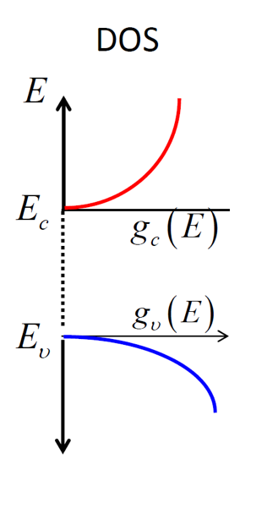


What we have learned in the last class?
E
f (E)
Electron concentration in conduction band
$$g_{c}\left(E\right)f(F)$$
E_{F}
Hole concentration in valance band
1 - f(E)
$$g_{v}\left(E\right)[1−f\left(F\right)]$$
1
What type of semiconductor it is?

Slide 4
Fermi Level, Population Density and Charge Carrier Distribution
n₀
E_{c}
E_{F}
E_{v}
N-type
N(E)
f(E)
Carrier Conc.
E_{c}
E_{F}
E_{v}
P-type
f(E)
N(E)
Carrier Conc.

Slide 5
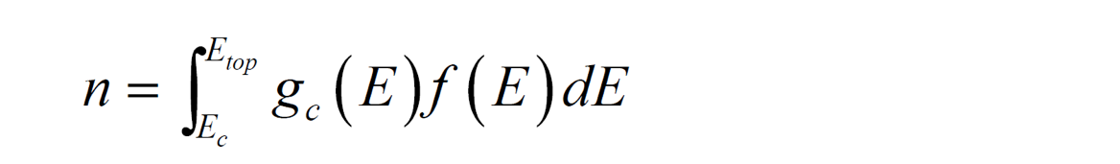
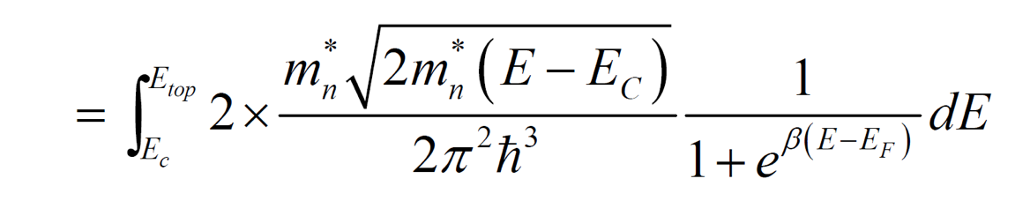
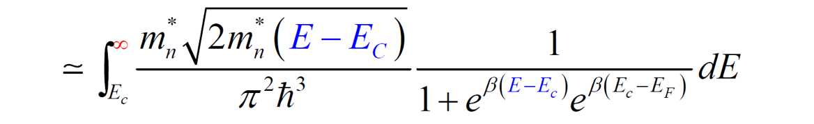
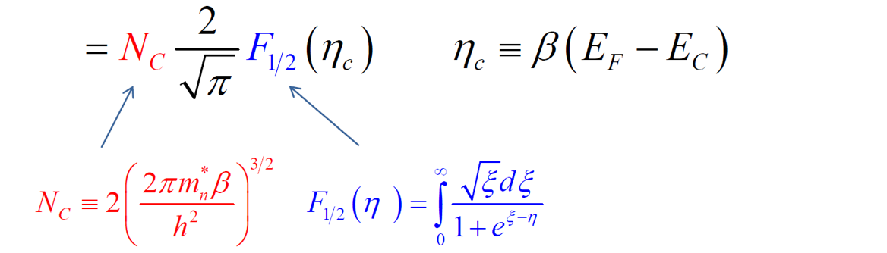
Electron Concentration

Slide 6
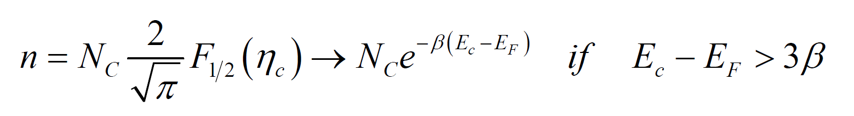
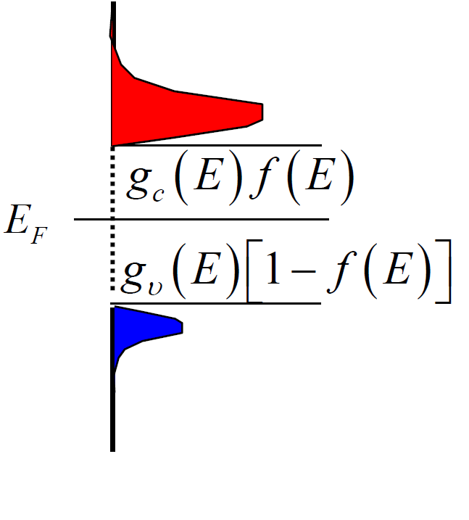
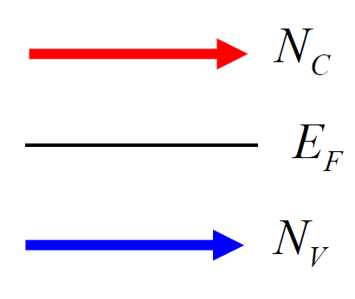
Effective Density of States

Slide 7
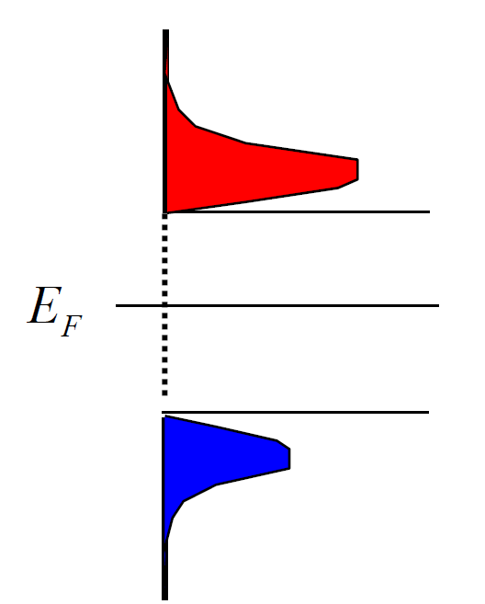
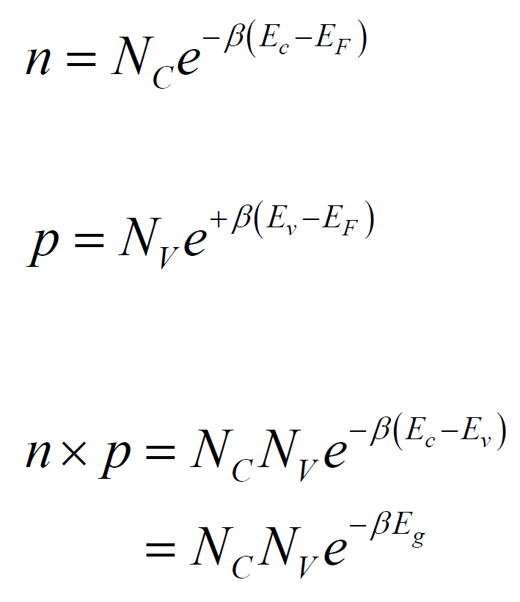
Law of Mass Action

Slide 8
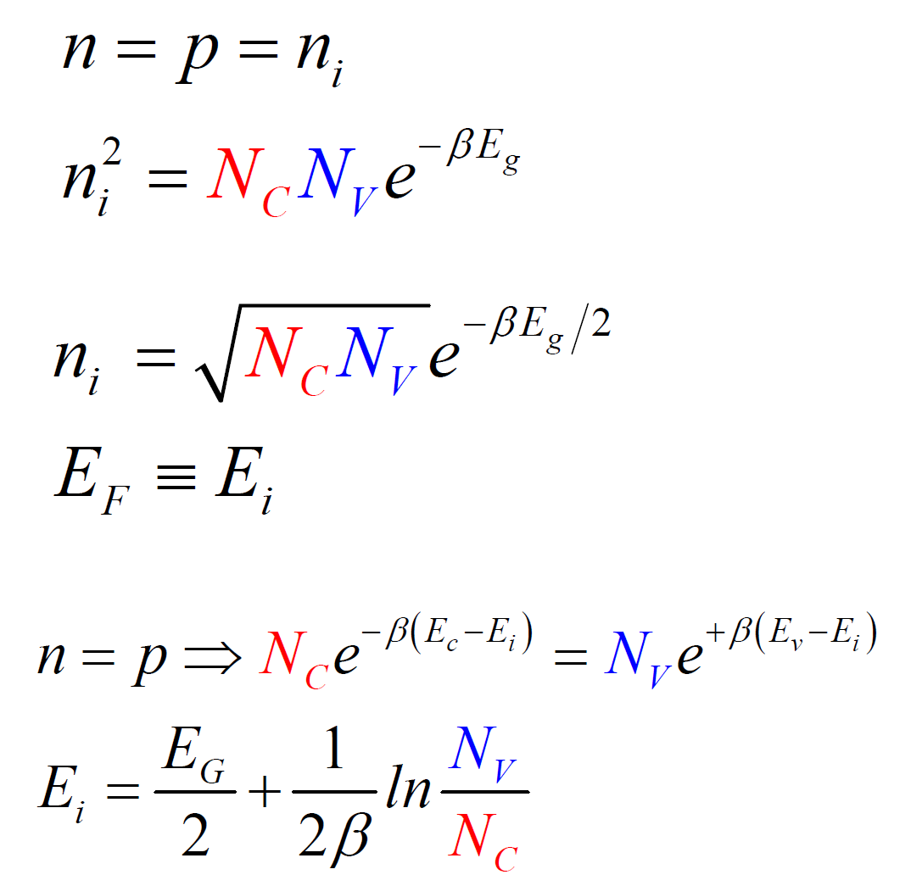
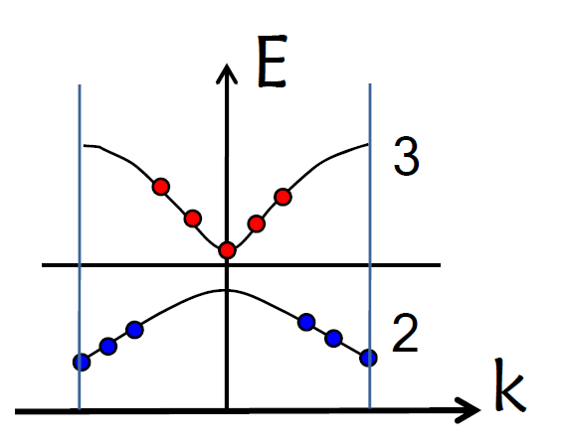
Fermi Level of Intrinsic Semiconductors
Position of the Fermi Level

Slide 9
Charge Carrier Concentration
On similar note one can derive
Extrinsic carrier concentrations in terms of intrinsic carrier conc.

Slide 10
Fermi Level, Population Density and Charge Carrier Distribution
n₀
E_{c}
E_{F}
E_{v}
N-type
N(E)
f(E)
Carrier Conc.
E_{c}
E_{F}
E_{v}
P-type
f(E)
N(E)
Carrier Conc.

Slide 11
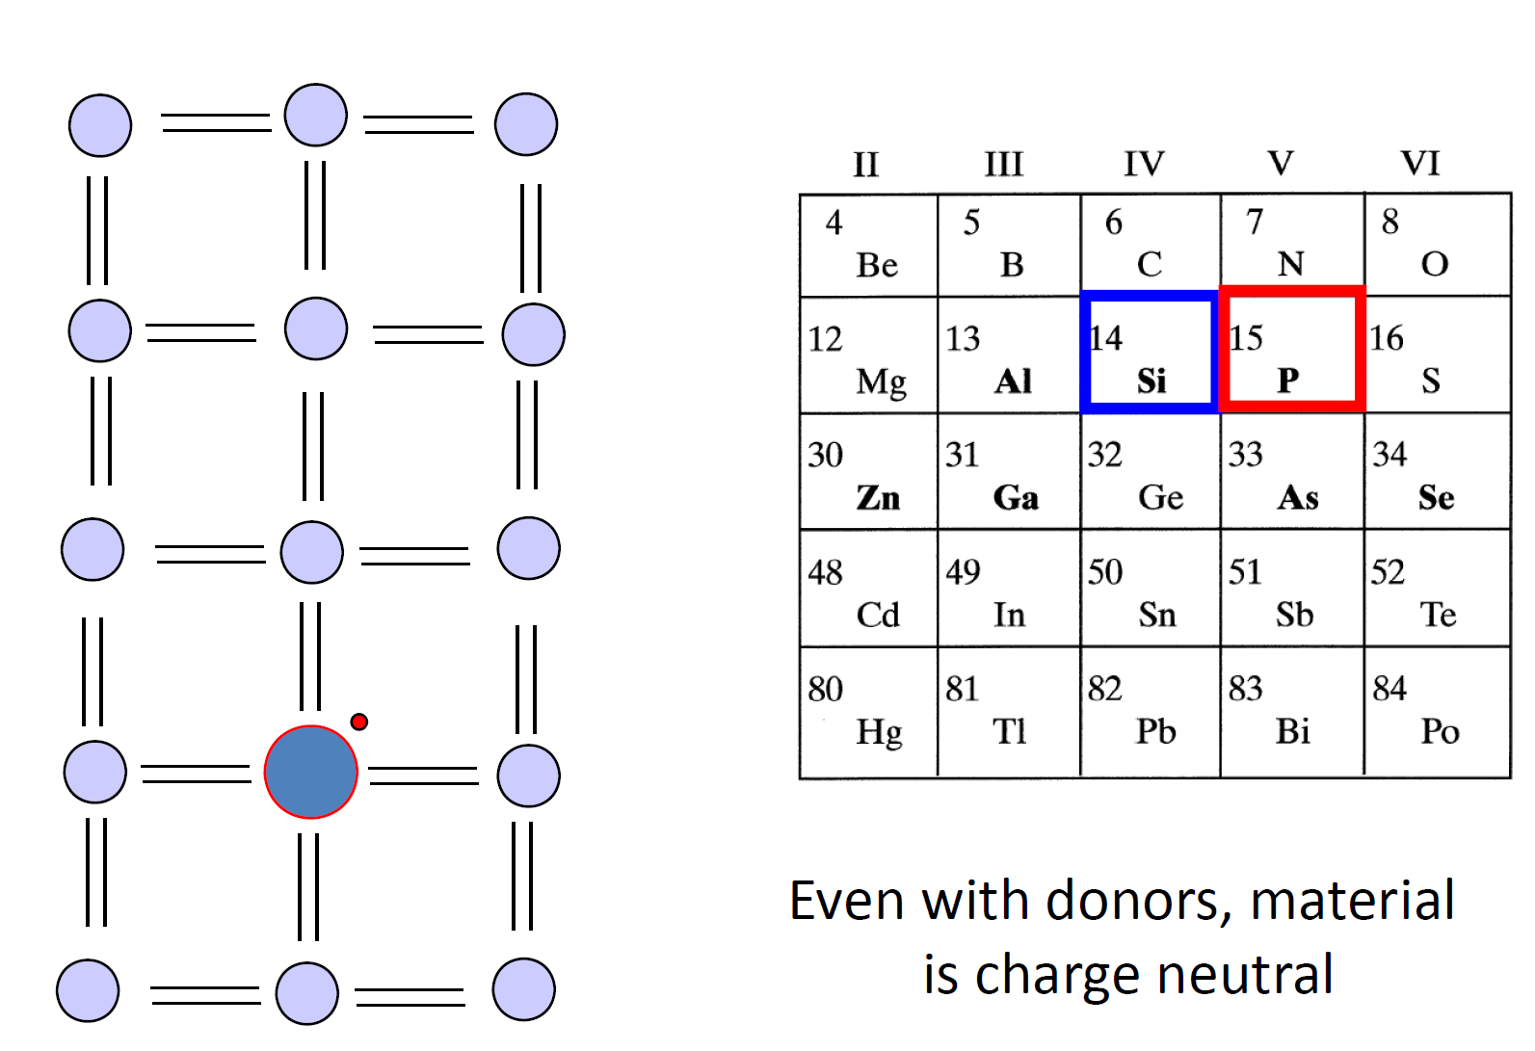
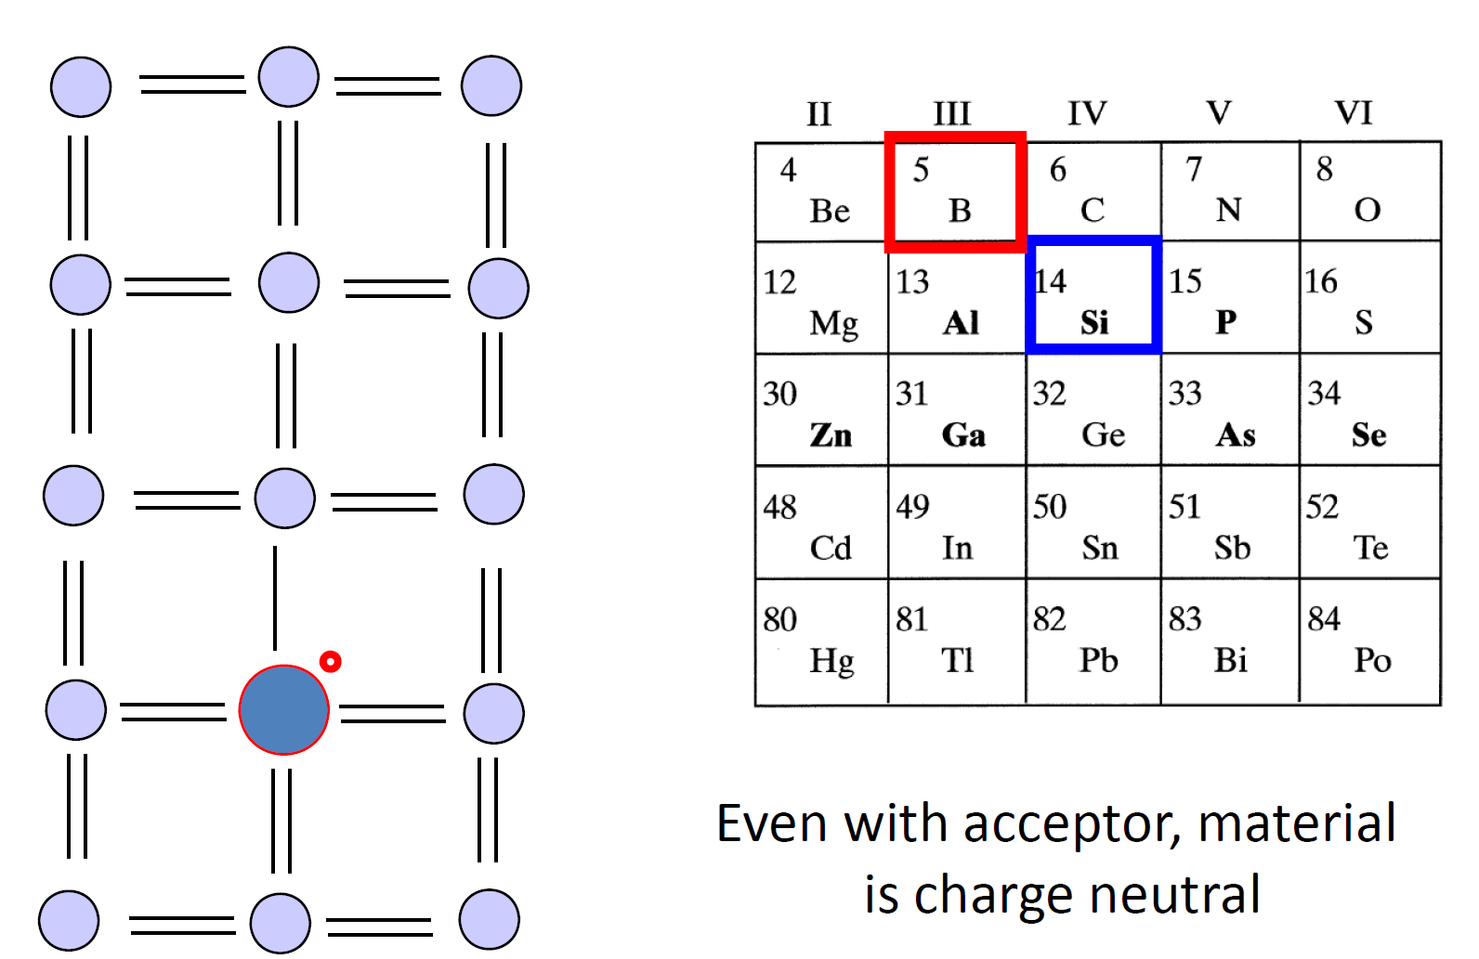
Donor and Acceptor in Host Materials
The number of donor atoms is much smaller compared to host atoms. Therefore, the electrons from one donor atom can go to the other donor atoms only via the conduction /valence bands of the host crystal. Just like a Hydrogen atom, it is possible to have multiple localized level for a given atom (see the blue levels).
Good donors live close to the conduction band, so that they can offer electrons easily.
However, if they are below the midgap, the donor levels are marked with (D) to differentiate them from acceptor atoms (live close to the valence band).
In either case the material will be charge nutral

Slide 12
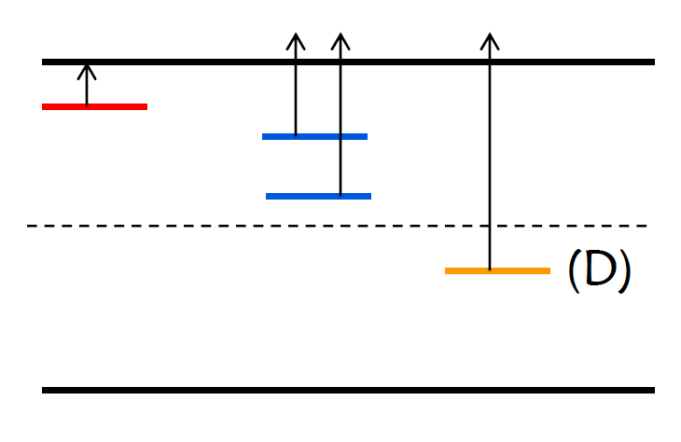
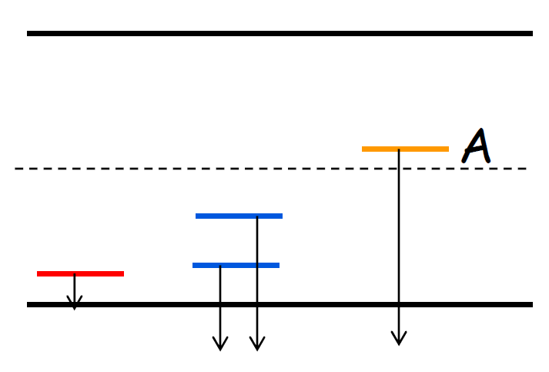
Donor and Acceptor levels

Slide 13
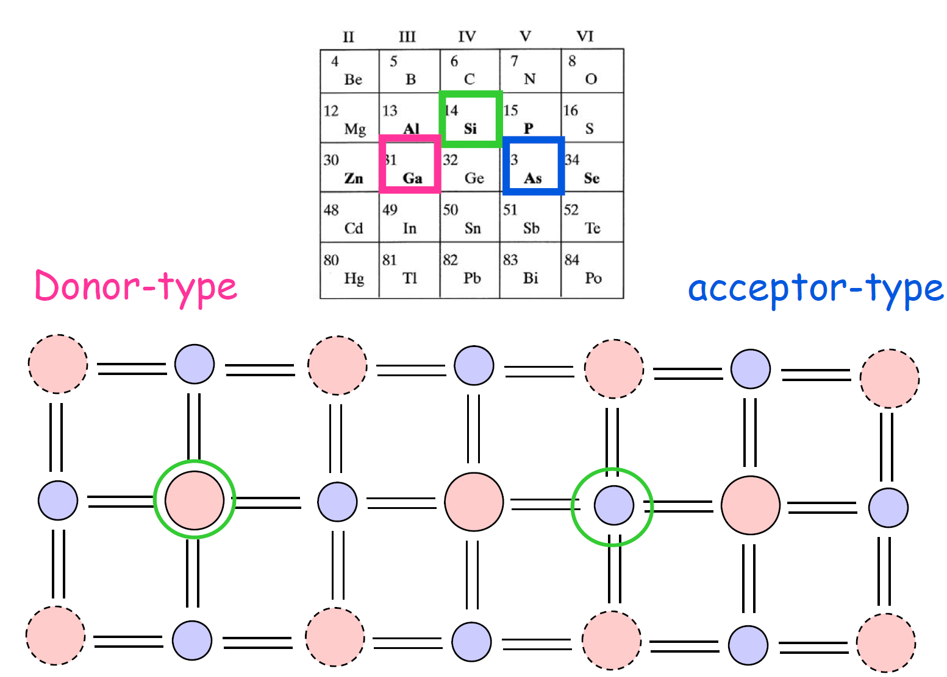
Amphoteric Dopants

Slide 14
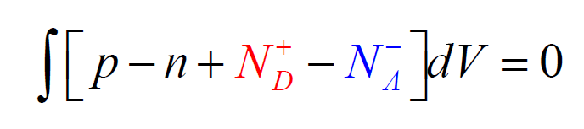
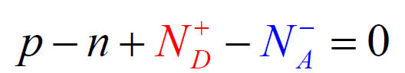
Donor and Acceptor statistics
What is the difference between N_{D} and N_{D}⁺ ?

Slide 15
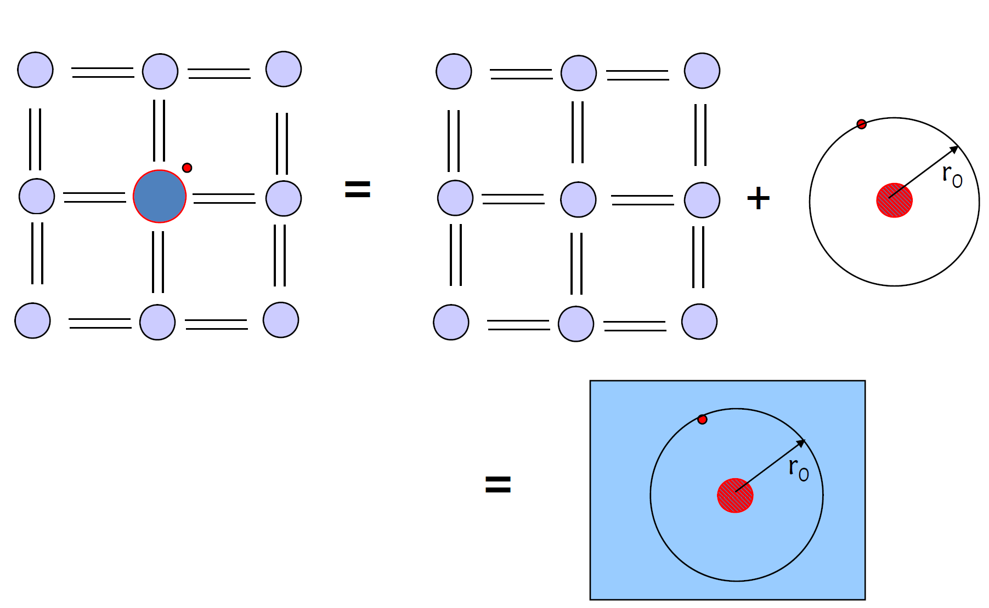
Donor Atoms in H₂ atom analogy

Slide 16
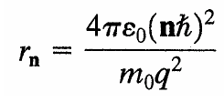
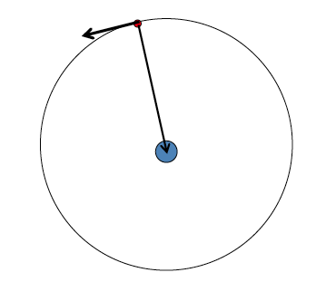
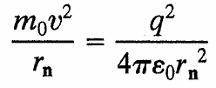
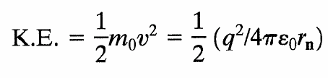


Recap : Hydrogen Atom
Equating both the forces: Coulomb force and Centrifugal force

Slide 17
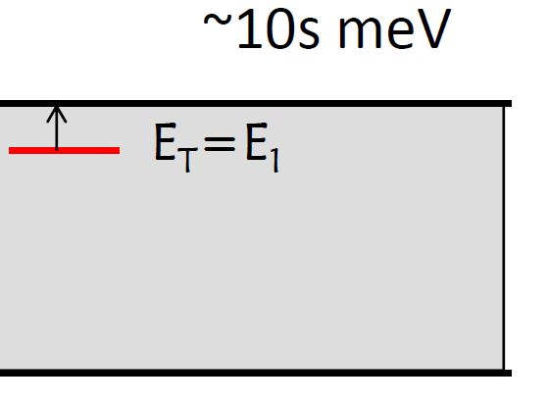
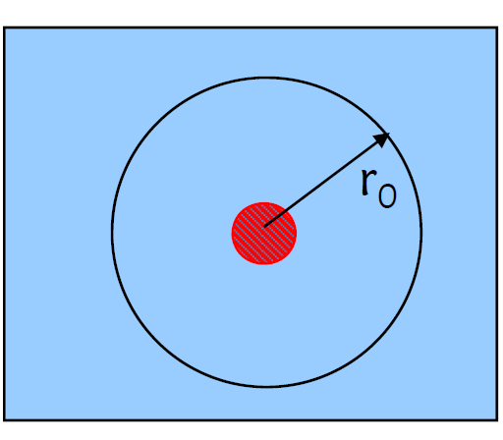
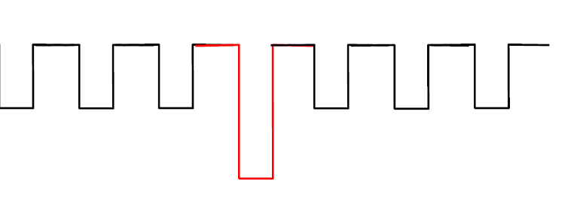
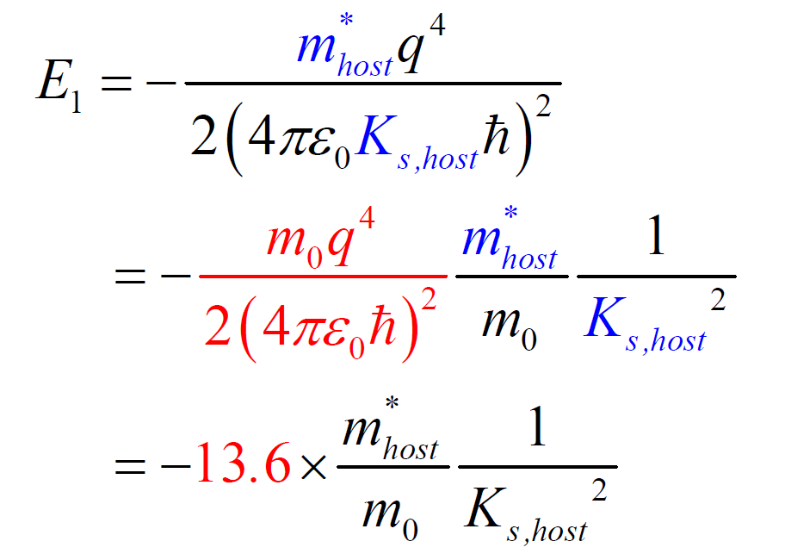
Donor Atoms in Real and Energy Space

Slide 18
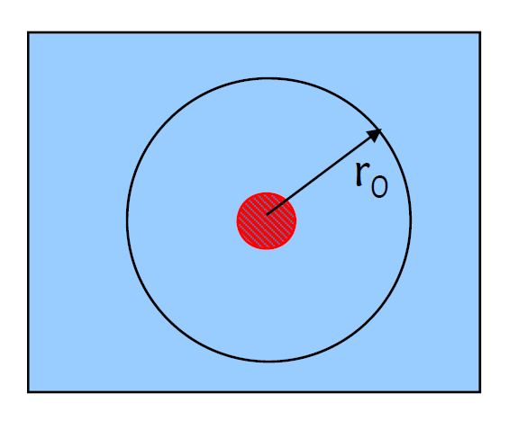
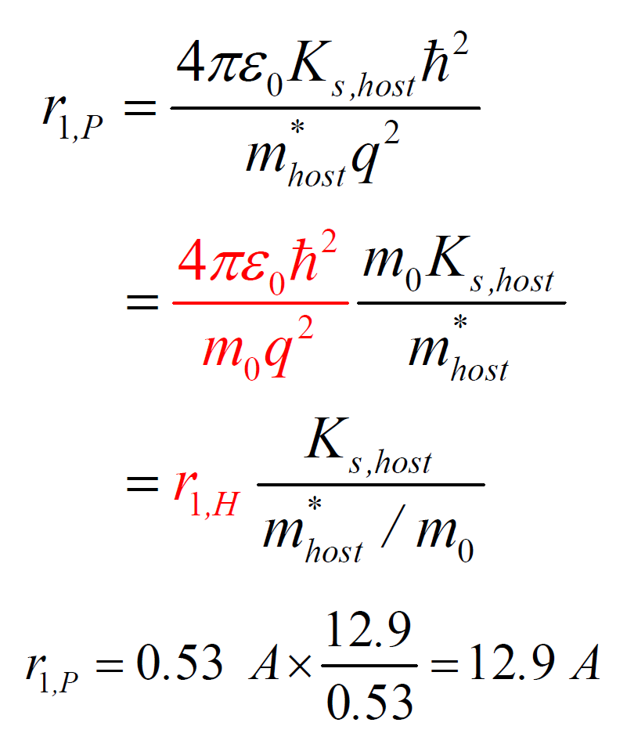
Donor Atoms in Real and Energy Space

Slide 19

Localized vs. Delocalized states
2N states

Slide 20
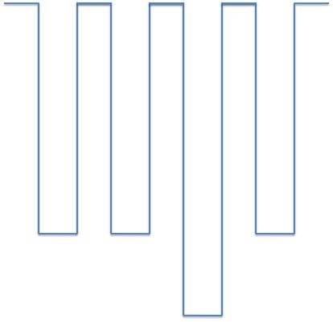
Localized vs. Delocalized states
2N-2 states

Slide 21
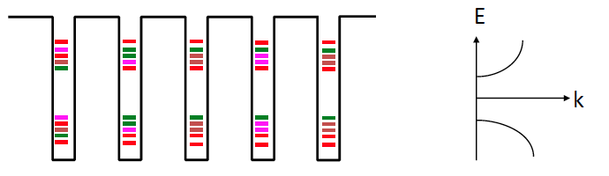
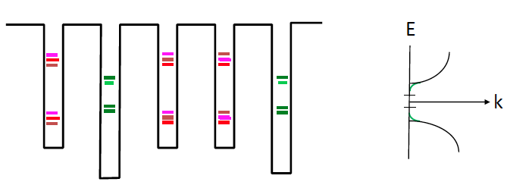
Heavy Doping – Band-tail states

